Slide 1







Java Generics
CS212:Data Structures

Slide 2
Outline
Problem definition
Solution using the casting
Solution using Generics

Slide 3





Problem
Data structures are used in various applications to store virtually any type of data.
How can we adapt the data structure code to new data types?
A solution is to rewrite the code each time we need to store a new data type (unrealistic).
Example: list of integers, list of doubles, list of characters.
The problem with this solution is : it is time and effort consuming and also error-prune.
In the rest, we will see two solutions to this problem,
one based on casting
the second on generic classes.

Slide 4










First solution: casting
The first solution takes advantage from the fact that all classes in Java derive from the class Object.
Instead of rewriting the code for every new class, we will write a single box class for data of type Object and use it to store all class data types.
Putting the data inside the data structure is simple and does not require any special treatment.
Retrieving the data from the data structure requires casting from Object to the original data type.

Slide 5
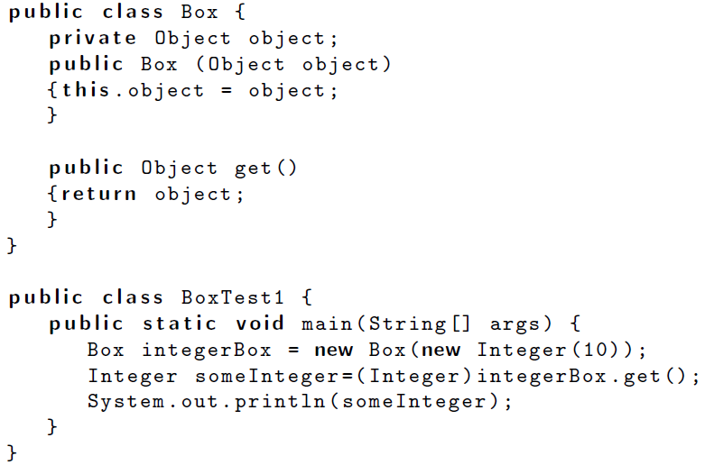






First solution: casting
This solution does not handle primitive data types as these are not classes. You need to use wrappers.

Slide 6
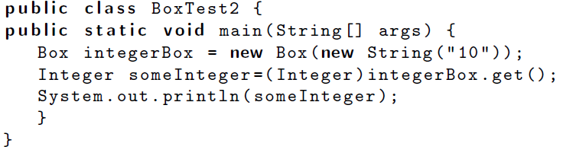
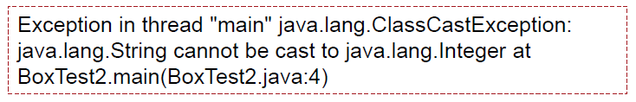


First solution: casting
If we pass a string as a parameter to the method, we need to change the casting type otherwise we get runtime exception (the compiler does not detect it).

Slide 7

First solution: casting
Advantages:
This solution is simple as it requires the code only once.
It handles class data types as well as primitive data types through the use of wrappers.
Disadvantages:
It allows for mixing data types, which is a bad practice.
It may lead to casting errors, when the data type inserted is different from the one we want to retrieve.
Casting errors are difficult, since they are runtime errors which are far harder to detect than compilation errors.

Slide 8








A Better Solution: Generics
It is possible to “parameterize” a class with the type of the object we expect it to contain using the <> syntax
Declares an attribute of type T instead of Object.
Compiler can now ensure only objects of the specific type are used.

Slide 9
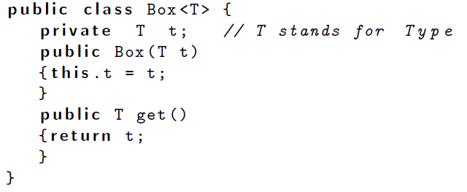





Writing a generic class
Box<T> is a generic class.
Use the <> syntax in the class definition,.
This is similar to declaring parameters in a method
Called Formal Type Parameters
The <T> declares that a type must be used when an instance is created
The type is then replaced everywhere where the ‘T’ is used in the class definition

Slide 10
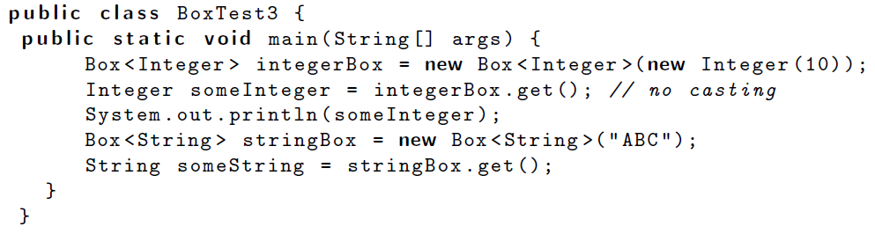


Using a generic class
Remark: no need to use the casting

Slide 11
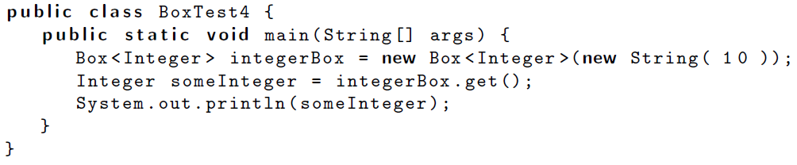





Using a generic class
BoxTest4.java:3: Box(java.lang.Integer) in Box<java.lang.Integer> cannot be applied to (java.lang.String)

Slide 12
A Better Solution: Generics
1) Type-safety : We can hold only a single type of objects in generics. It doesn’t allow to store other objects.
2) Type casting is not required: There is no need to typecast the object.
3) Compile-Time Checking: It is checked at compile time so problem will not occur at runtime. The good programming strategy says it is far better to handle the problem at compile time than runtime.

Slide 13
ToDo
Read the text book: section 2.5

